Slide 1
E-commerce Product and Review Scraper
Project Purpose and Goals: To develop an efficient web scraper for e-commerce data collection and analysis.

Slide 2
Group Members & Contact Info
Group Members:
Almaamar Alkiyumi – alkiyuam@mail.uc.edu
Jason Yang – yang2j7@mail.uc.edu
Matt Myers – myers3jm@mail.uc.edu
Advisor:
Matt Hunter – hunter.matthew@midea.com

Slide 3
Project Abstract
This project focuses on building an improving a web scraper to collect product and review data from e-commerce websites. Using tools like Scraping Bee, AWS, Selenium, and Pandas, the system retrieves, processes, and stores the data for analysis. Key features include cost-effective solutions, user-friendly interfaces, and comprehensive data extraction and analysis functionalities.

Slide 4
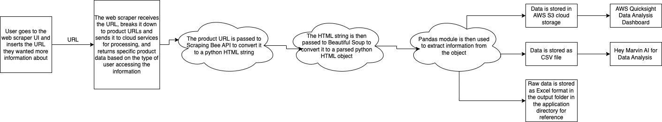
User Stories and Design Diagrams
As a business analyst, I want to scrape product data from multiple e-commerce websites so that I can efficiently gather information for market research and pricing analysis.
As a developer, I want to update the scraper’s hardcoded components through an easy-to-use interface so that I can quickly adapt to website changes without manual code edits.
As an engineer, I want to scrape data from a specific product page by entering a URL so that I can retrieve the information I need without learning to code.
As a business user, I want to filter the scraped data by specific parameters like price or category so that I can extract only the most relevant information for my reports.

Slide 5
Major Project Constraints
Economic: The project is funded with a budget of about $200 per month, requiring cost-effective solutions.
Security: Ensuring data privacy and protection while storing scraped data on AWS.
Legal: Complying with website terms and intellectual property laws to avoid legal issues.
Ethical: Scraping data ethically without violating user privacy or terms of service.

Slide 6
Review of Project Progress
Currently, the web scraper is able to retrieve product URLs and basic data. The cloud storage integration with AWS has been set up, and preliminary data analysis using Pandas has been tested. The UI for users and developers is in development.

Slide 7
Expected Accomplishments for End of Term
By the end of the term, we expect to have a fully functional web scraper capable of collecting and processing large-scale data from e-commerce websites. The UI will be complete, and the system will be optimized for cost-efficiency and accuracy.

Slide 8

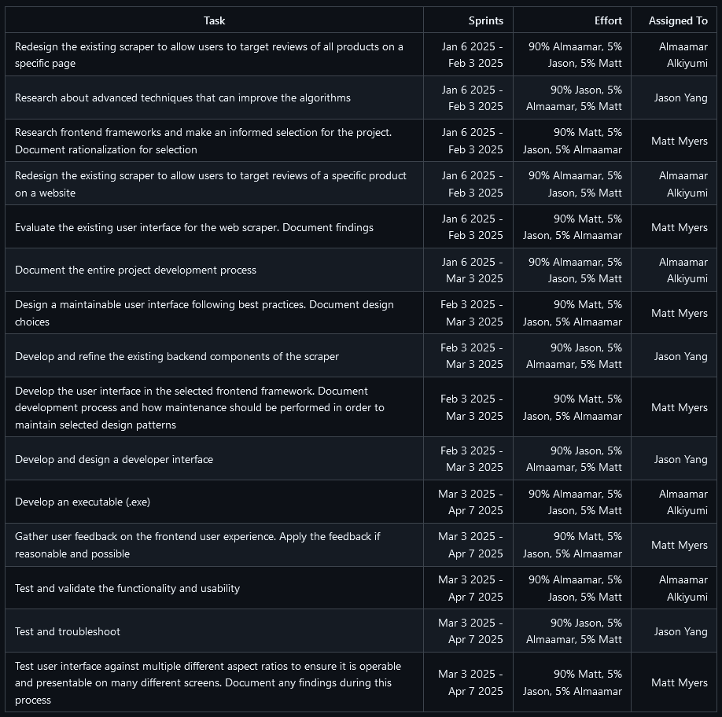
Division of Work
Almaamar:
Backend development (web scraping, data extraction)
Redesigning the scraper to target specific product reviews
Documenting the project development process
Matt:
Frontend development (UI, dashboard design)
Developing and designing the developer interface
Gathering user feedback on frontend user experience and applying changes
Jason:
Data analysis and cloud integration (AWS, Pandas, storage optimization)
Evaluating and refining the existing user interface
Testing and troubleshooting integrations within existing systems

Slide 9
Expected Demo at Expo
We plan to demonstrate the full functionality of our web scraper at the expo. The demo will show the process of scraping product and review data, storing it in the cloud, and analyzing it using AWS QuickSight for visual insights.

